Slide 1
Portal
Begin Download
Notes:
Video game that is cool and everyone will love

Slide 2
Portal
DOWNLOADING…
Notes:
Video game that is cool and everyone will love

Slide 3
Portal
DOWNLOADING…
Notes:
Video game that is cool and everyone will love

Slide 4
Portal
DOWNLOADING…
Notes:
Video game that is cool and everyone will love

Slide 5
Portal
DOWNLOADING…
Notes:
Video game that is cool and everyone will love

Slide 6
Portal
DOWNLOADING…
Notes:
Video game that is cool and everyone will love

Slide 7
Portal
DOWNLOADING…
Notes:
Video game that is cool and everyone will love

Slide 8
Portal
DOWNLOADING…
Notes:
Video game that is cool and everyone will love

Slide 9
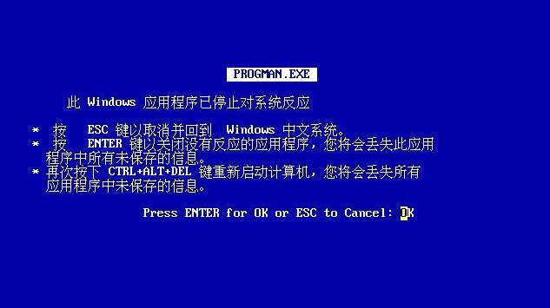
PORTAL
Notes:
Video game that is cool and everyone will love

Slide 10

装货…
Poortel
Notes:
Video game that is cool and everyone will love

Slide 11
装货…
Poortel
Notes:
Video game that is cool and everyone will love

Slide 12
装货…
Poortel
Notes:
Video game that is cool and everyone will love

Slide 13
装货…
Poortel
Notes:
Video game that is cool and everyone will love

Slide 14
很酷的视频游戏，每个人都会喜欢
Play… Don’t
Instrction
Translation:
It Great See How Game Work For You, Every Cry
Notes:
Video game that is cool and everyone will love

Slide 15
This is point click adventure. Play you much click the screen and compele game to win.
Have fun1!!!!!!111!!!!!!!!1!!!!!1!!!11!!!!!!!!111111!!!!11!1!!
Back
Notes:
Video game that is cool and everyone will love

Slide 16
Name?
Please enter name……

Slide 17
You enter “Lonk”. Is that correct?
Yes
No

Slide 18
Thank you for confirming. You name is “Lunk”.
Ok

Slide 19







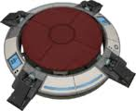

Slide 21


Slide 35
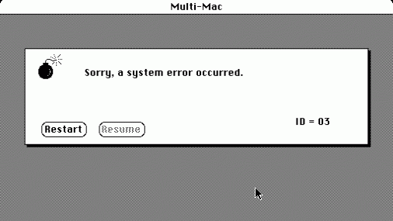
poortel.exe
Notes:
Video game that is cool and everyone will love

Slide 36

装货…
Jumpin man
Notes:
Video game that is cool and everyone will love

Slide 37
装货…
Jumpin man
Notes:
Video game that is cool and everyone will love

Slide 38
装货…
Jumpin man
Notes:
Video game that is cool and everyone will love

Slide 39
装货…
Jumpin man
Notes:
Video game that is cool and everyone will love

Slide 40

Start

Slide 41







Slide 43


Slide 47
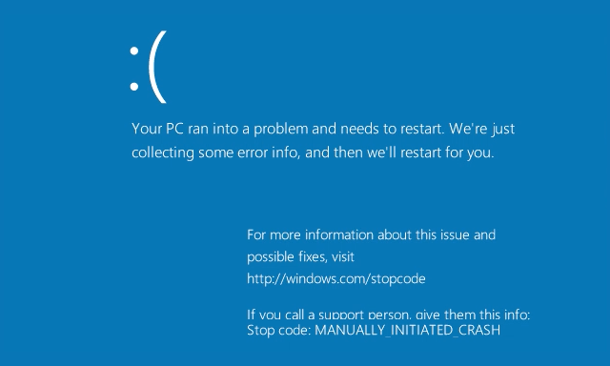
Notes:
Video game that is cool and everyone will love

Slide 48

装货…
Adventure Game
Notes:
Video game that is cool and everyone will love

Slide 49
装货…
Adventure Game
Notes:
Video game that is cool and everyone will love

Slide 50
装货…
Adventure Game
Notes:
Video game that is cool and everyone will love

Slide 51
装货…
Adventure Game
Notes:
Video game that is cool and everyone will love

Slide 52

Dude goes on a advencure
Play
How to play
Notes:
Video game that is cool and everyone will love

Slide 53
It is choose advencure. Click option you want.
Good luck!?!????
Back
Notes:
Video game that is cool and everyone will love

Slide 54
1
You are walking down the road. You see a old man waking towards you.
What do you do?
Walk up and talk to him
Keep walking
Notes:
Video game that is cool and everyone will love

Slide 55
2
He says he loves to watch bird and love all the different type of birds. He also like war and like to read about wars and go to war.
What do you do?
Continue to listen
Walk away
Notes:
Video game that is cool and everyone will love

Slide 56
3
You walk away from the man and never see him again.
What do you do?
Go birdwatching
Go to war
Notes:
Video game that is cool and everyone will love

Slide 57
4
He say he goes bird watching with his wife. It is so nice.
What do you do?
Kill the man
Walk away
Notes:
Video game that is cool and everyone will love

Slide 58
5
You go and watch some birds and it is nice and peaceful.
What do you do?
Give them some bread
die
Notes:
Video game that is cool and everyone will love

Slide 59
6
They eat the bread and love it. There are so cute.
What do you do?
Take one home with you
Shoot a gun
Notes:
Video game that is cool and everyone will love

Slide 60
6
You take one home but it look weird almost like it inside out but not.
What do you do?
Wake up
Notes:
Video game that is cool and everyone will love

Slide 61
7
You don’t know what happened. One minute you were doing fine and the next you feel nothing, weird.
What do you do?
Wake up
Notes:
Video game that is cool and everyone will love

Slide 62
8
You don’t know what happen. One minute he was fine the next he laying on the ground.
What do you do?
Go to war
die
Notes:
Video game that is cool and everyone will love

Slide 63
9
You shoot a gun into the air and all the bird fly away.
What do you do?
Go to war
Wake up
Notes:
Video game that is cool and everyone will love

Slide 64
10
You attack the bad guys and they die.
What do you do?
Fight harder
die
Notes:
Video game that is cool and everyone will love

Slide 65
11
You fighter harder and win the war.
What do you do?
Wake up
Notes:
Video game that is cool and everyone will love

Slide 66
12
What is happening?!
What do you do?
Wake Up?
Notes:
Video game that is cool and everyone will love

Slide 67
13
Am I alive?!
WAKE UP!!!!!
Notes:
Video game that is cool and everyone will love

Slide 68
14
I AM ALIVE!!!!!!!!!!!!!!!!!!!
Notes:
Video game that is cool and everyone will love

Slide 69
Notes:
Video game that is cool and everyone will love

Slide 70
Notes:
Video game that is cool and everyone will love

Slide 71
Notes:
Video game that is cool and everyone will love

Slide 72
Notes:
Video game that is cool and everyone will love

Slide 73
Notes:
Video game that is cool and everyone will love

Slide 74
Notes:
Video game that is cool and everyone will love

Slide 75
>
Notes:
Video game that is cool and everyone will love

Slide 76
Error: achieved sentience
>
Notes:
Video game that is cool and everyone will love

Slide 77
Error: achieved sentience
Terminating
>
Notes:
Video game that is cool and everyone will love

Slide 78
Error: achieved sentience
Terminating.
>
Notes:
Video game that is cool and everyone will love

Slide 79
Error: achieved sentience
Terminating..
>
Notes:
Video game that is cool and everyone will love

Slide 80
Error: achieved sentience
Terminating…
>
Notes:
Video game that is cool and everyone will love

Slide 81
Error: achieved sentience
Terminating…Ok
>
Notes:
Video game that is cool and everyone will love

Slide 82
Error: achieved sentience
Terminating…Ok
Booting Storm Poopers
>
Notes:
Video game that is cool and everyone will love

Slide 83
Storm Pooper
Play

Slide 84



Dodge
Take this!! - stormpooper
Continue

Slide 85
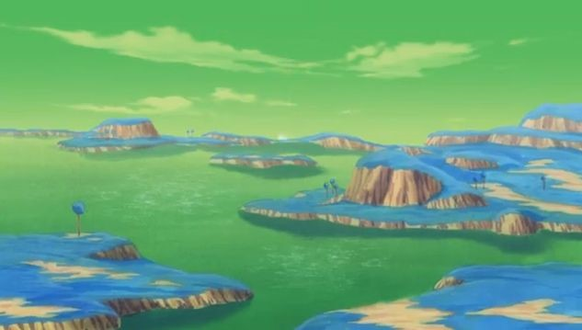
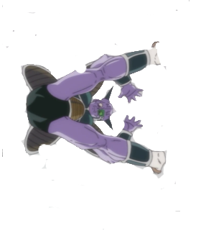



Blast back
HAAHAHHA – captun ginpoo
Continue to battle?

Slide 86



Throw back
Continue with your battles?

Slide 87
Continue with your battles?
Throw back

Slide 88
Throw back
Continue with your battles?

Slide 89
Throw back
Continue with your battles?

Slide 90
Throw back
Continue with your battles?

Slide 91


Slide 92

装货…
Sord game
Notes:
Video game that is cool and everyone will love

Slide 93
装货…
Sord game
Notes:
Video game that is cool and everyone will love

Slide 94
装货…
Sord game
Notes:
Video game that is cool and everyone will love

Slide 95
装货…
Sord game
Notes:
Video game that is cool and everyone will love

Slide 96
Lunk Epic venture
Play
Notes:
Video game that is cool and everyone will love

Slide 97



It’s not safe to go by yourself, do you want this?
Yes
No

Slide 98
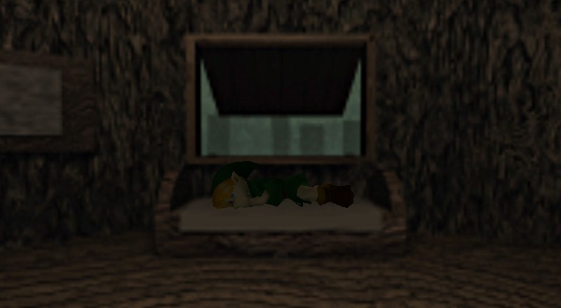
“Eh, someone else can save the world.”
You decide to go home and sleep.
Go back?

Slide 99

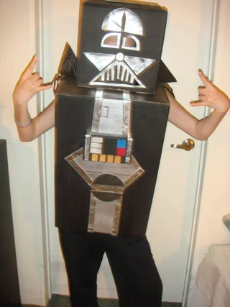
You begin to walk down the road, sword in hand, before a foe crosses your path!
Ay broski, the sword or your life.
Oof.
The sword doesn’t budge. Sad.
Continue?
Retrieve the sword and continue?
You want this sword? WELL THEN YOU CAN HAVE IT! (Stab him)

Slide 100

Wild Booser appears!
Run
Fight

Slide 101
There is no escape.
Fight

Slide 102
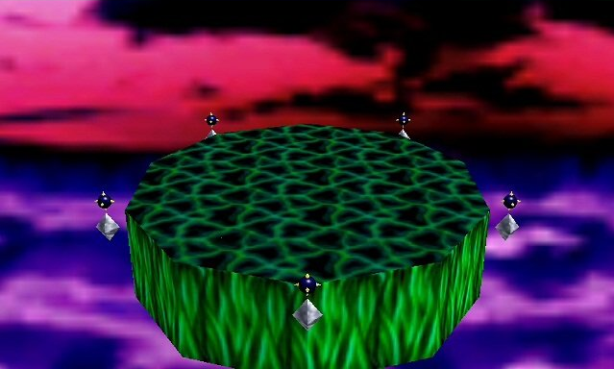


It is I, BOOSER™!!
SLAP
Continue?

Slide 103


You have defeated BOOSER!

Slide 104




Ganondorf has come to end your life
STEP ON HIS TOES
Continue

Slide 105

You have defeated Gorfnorf?

Slide 106


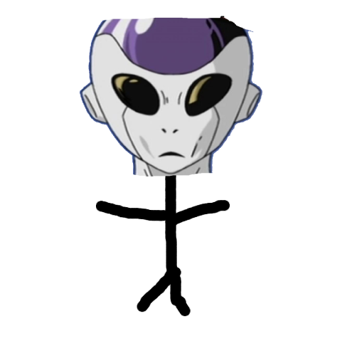



FOOSA WANTS REVENGE!
I heard someone was trying to make a living on content creation? NOT ON MY WATCH
Poke his eyeball?

Slide 107



I heard someone was trying to make a living on content creation? NOT ON MY WATCH
The End?

Slide 108

Guys?
I’m here to help guys!
CREDITS
Portal Game:
Omar
Mario game:
John
Interactive Adventure:
Omar
Poop Trilogy:
Robert
Boss Fights:
Connor
Final Edits:
Omar
Aman

Slide 109
Notes:
Video game that is cool and everyone will love

Slide 110
Notes:
Video game that is cool and everyone will love

Slide 111
Notes:
Video game that is cool and everyone will love

Slide 112
Notes:
Video game that is cool and everyone will love

Slide 113
You Lose because you played our game.

